Slide 1

RC Monthly Mindfulness
Come Fill Your Cup
Offered by the Traumatic Stress Institute of Klingberg Family Centers

Slide 2
Agreements
Focus on well-being - Fill your cup
Sustain RC culture - Pour from a full cup
Do no harm - Care for your cup
  All practice is optional
  Take a break or stop if feeling distressed
  Be kind and gentle, with self and others
  Seek support as needed

Slide 3

Gratitude
Affirmation of goodness in the world - events, people and experiences from which we have benefited
Recognition of sources of goodness - things and people outside of ourselves that generate the goodness we receive

Slide 4
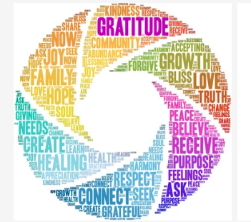
Benefits of Gratitude
Increases happiness and life satisfaction
Boosts feelings of optimism, joy, pleasure and enthusiasm
Improves our relationships
RC Application: RICH Relationships
Foster sense of Hope, that there is and will be goodness in the world
Foster belief that others offer goodness, helps build and repair Connection

Slide 5

Barriers to Gratitude
Sign of dependence or weakness
Form of social obligation, a “should”
Dismissive of bad things, of harm
RC Application:
May reinforce not feeling worthy of life
May trigger shame, can be hard to feel grateful
  For clients who have endured trauma
  For staff who have endured VT

Slide 6
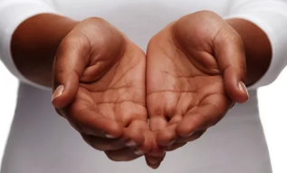
Invite Gratitude
Gratitude practice as an option, never a should
Despite harm and hardship, gratitude is available as a choice
RC Application:
Model gratitude (without expectation)
Invite gratitude (without expectation)

Slide 7
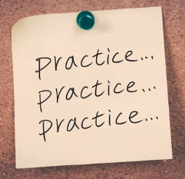
Gratitude Practice
Write 2-3 things for which you feel grateful (positive events, experience, person or thing in your life)
  Be specific: Offer specific examples versus generalizations…
  Go for depth over breadth: Elaborate on the details…
  Get personal: Focus on people versus things…
RC Application:
Personal gratitude practice (journaling)
Post gratitude statements (staff/client)
Open meetings with gratitude sharing
Include gratitude in supervision
Offer gratitude to a person (staff/client)
Notes:
Example: I appreciate the opportunity to offer this monthly mindfulness program. I’m grateful that my TSI colleagues have supported a vision for developing mindfulness programs for the RC community. Steve – has approved my participation in mindfulness conferences and trainings. Pat has been a thinking partner on content development. Chris has enthusiastically broadcast messaging and content about program offerings. Callie has helped set up our contact management system to make seamless communication about the offerings possible. Mary Jo has been a consistent supporter of mindfulness benefits with our client agencies. And, I’m grateful to each of you for your presence in today’s session, sharing your time to be part of this growing community.

