Slide 1

RC Monthly Mindfulness
Come Fill Your Cup
Offered by the Traumatic Stress Institute of Klingberg Family Centers

Slide 2
Agreements
Focus on well-being - Fill your cup
Sustain RC culture - Pour from a full cup
Do no harm - Protect your cup
  All practice is optional
  Take a break or stop if feeling distressed
  Be kind and gentle, with self and others
  Seek support as needed

Slide 3
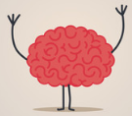
Cognitive Empathy
Understand how others think, see another’s perspective
RC Application:
Teen client thinks it’s unfair that mother did not show up for visit
CE helps see and understand teen’s perspective

Slide 4

Emotional Empathy
Feeling another’s feelings (including pain and distress)
Activates neural networks (including pain and distress)
Can lead to empathetic distress (and maybe tuning-out or problem solving)
RC Application:
Teen feels hurt, sense of abandonment when mother does show up for visit
EE helps us feel in our own body what the client is feeling

Slide 5
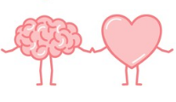
Compassion/Empathetic Concern
Feeling concern for another who is suffering
Activates neural networks for positive feelings, love
Prepares us to turn toward other and act to alleviate suffering
RC Application:
We feel concern for the teen and are moved to take action aimed at alleviating suffering

Slide 6
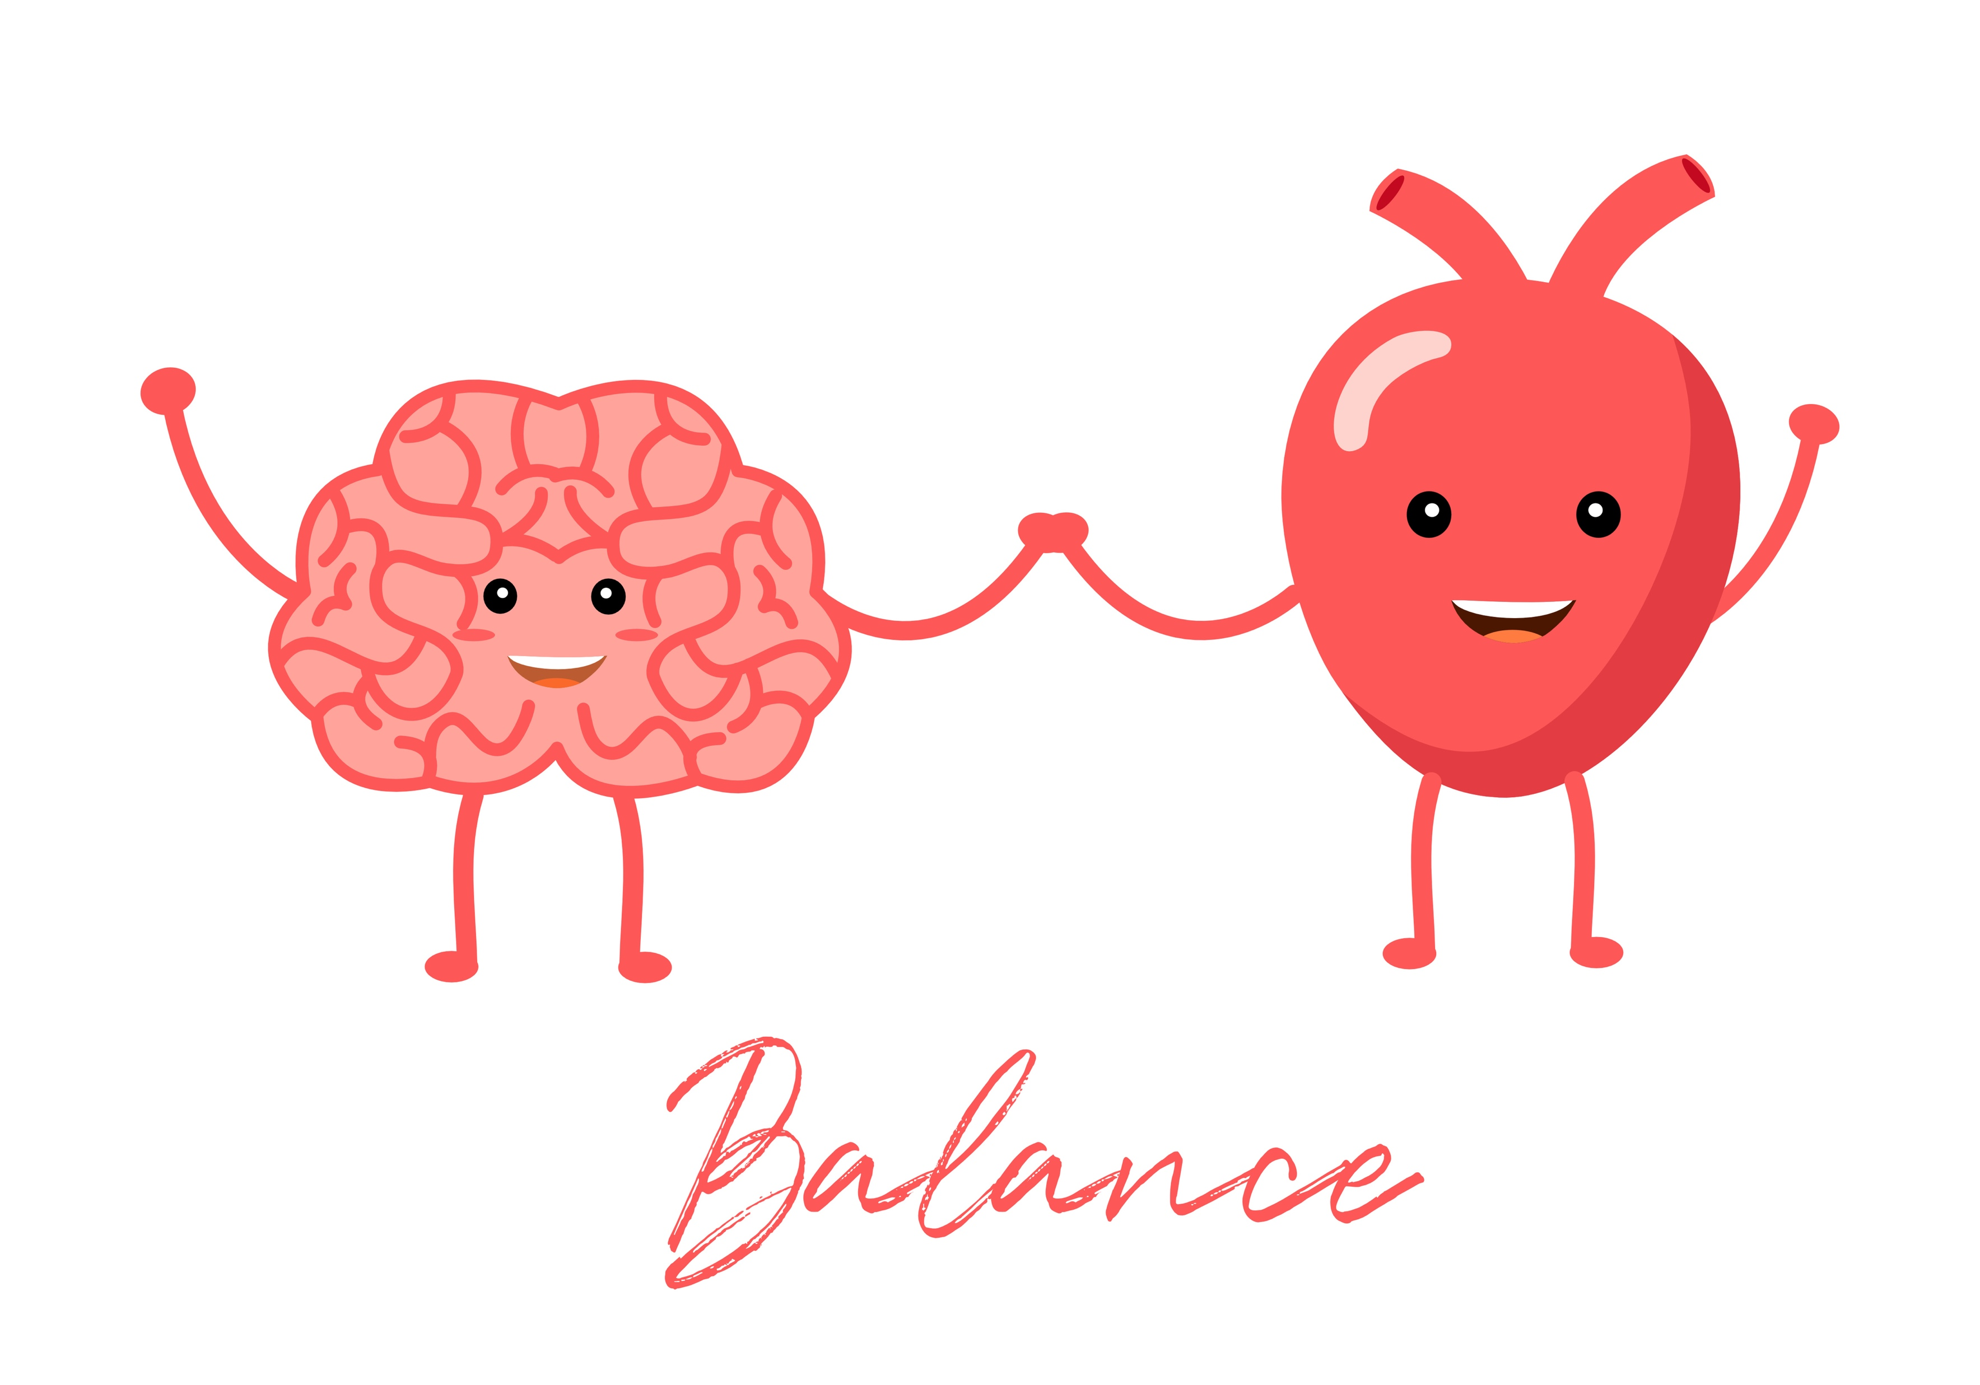
Compassion Meditation
Builds capacity for compassion, turn toward suffering
Measurable results within 8 hrs. of practice
Decrease unconscious bias within 16 hrs. of practice
RC Application:
Compassion Meditation
Self-Compassion Meditation

